Slide 1
PMI Code of Ethics
Presented and submitted to
Rezvi Shahariar
Submitted by
Shahla Shaan Ahmed - 0810
Tulshi Chandra Das - 0811

Slide 2
Outline
What is PMI Code of Ethics
Persons to Whom the Code Applies
Values
Responsibility
Respect
Fairness
Honesty

Slide 3

What is PMI Code of Ethics
This Code of Ethics and Professional Conduct describes the expectations that PMI members have of themselves and their fellow practitioners in the global project management community.
source:https://pbs.twimg.com/profile_images/852659744078680065/pW4vxn1x_400x400.jpg

Slide 4

Persons to Whom The Code Applies
All PMI members
Non-members who hold a PMI certification
Non-members who apply to commence a PMI certification process
Non-members who serve PMI in a volunteer capacity
Source: https://wp5ct2ln3336u64d27k6i319-wpengine.netdna-ssl.com/wp-content/uploads/2017/09/pmi-member-1.png

Slide 5
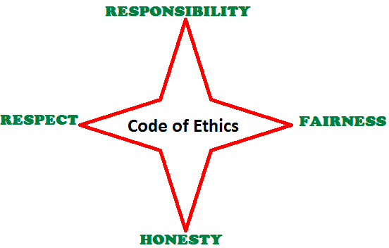
Values
http://www.kodyaz.com/images/pmp/pmi-code-of-ethics-four-values.png

Slide 6
Responsibilities
Aspirational Standards
Making decisions and take actions
Fulfilling the commitments
Protecting proprietary , confidential information
Mandatory Standards
Upholding policies , rules , regulations and law
Reporting unethical or illegal conduct
Bringing violations of this Code to the attention

Slide 7
Respect
Aspirational Standards
Knowing the norms and customs of others
Listening to others’ points of view
Maintaining professional manner
Mandatory Standards
Not using the power of position
Not acting in an abusive manner
Respecting the property rights

Slide 8
Fairness
Aspirational
Demonstrating transparency in decision-making
Reexamine impartiality and objectivity
Provide equal access to information to authorized people
Mandatory
Handling conflict of Interest Situations
Avoiding favoritism and Discrimination

Slide 9
Honesty
Aspirational
Seeking to understand the truth
Being truthful in communications and in conduct
Providing accurate information in a timely manner
Mandatory
Not engaging in behavior that deceive others
Not making misleading or false statements
Avoiding act behavior for personal gain

